Slide 1

APACHE SPARK ARCHITECTURE

Slide 2
Apache Spark:-Initial release on May 26th,2014. Developed by Databricks,Apache Software Foundation.
Apache Spark is an open-source distributed computing system designed for big data processing and analysis.
In memory processing.
Spark provides an interface for programming clusters.
It is high on speed and easy to use.
It support many programming language like python , java and Scala etc.

Slide 3
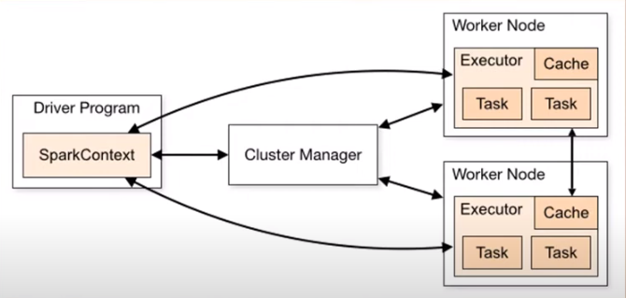
Spark Architecture:-It works on master and slave Architecture.

Slide 4
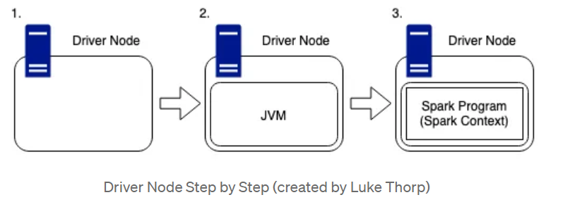
Driver Node: The driver node is responsible for managing the overall execution of the Spark application. It defines the application's logic, coordinates tasks, and interacts with the cluster manager to acquire resources.
Cluster Node : Spark can integrate with various cluster managers, such as Apache Mesos, Hadoop YARN, or Spark's standalone cluster manager. The cluster manager allocates resources and handles task scheduling across the cluster.
Executors: Executors are worker processes running on the cluster nodes. They execute tasks assigned by the driver program and store data in memory or on disk
Executors run in separate Java Virtual Machines (JVMs) and are responsible for managing the computation and storage resources on each node.

Slide 5
Executors execute program in three modes:-
Cluster Mode:- In cluster execution mode, Spark runs on a cluster of machines, allowing for distributed processing of data across multiple nodes. This mode is used for large-scale data processing and allows Spark to take advantage of the resources available across the cluster.
Client Mode:- The client mode is deployed with the Spark shell program, which offers an interactive Scala console. Use this mode when you want to run a query in real time and analyse online data.
Local Mode:- In local execution mode, Spark runs on a single machine, typically for development, testing, or small-scale data processing. It allows you to test and develop Spark applications without the need for a distributed cluster setup.

Slide 6
Abstraction of Apache Spark:
Spark has two abstraction Rdds and dag
RDDs:Resilient Distributed Datasets.
RDDs are core of data abstraction in spark.
They are fault –tolerant ,immutable distributed collection of object.
RDDs can be created from data stored in Hadoop Distributed File System (HDFS), local file systems, or other data sources. RDDs support various transformations and actions for processing data in parallel.
Apache spark
RDDS
DAG

Slide 7
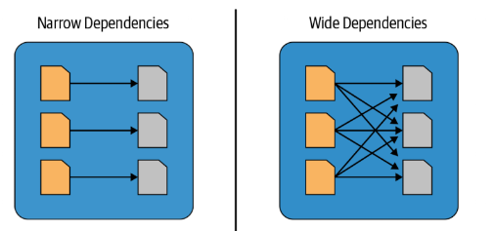
Rdds Operation:-Rdds performs two operations. Transformation and Action.
1 Transformations: Transformations are operations that enable you to create new RDDs from existing ones by applying various data transformations.
Ex: var a=sc.textfile(“hdfs://….”) RDDS0
var b=a.filter() RDDS1
var c =b.distinct RDDS3
Transformations Type:-There are two type of transformations.
Narrow transformation
Wide transformation

Slide 8
Narrow Transformations:
Narrow transformations transform data without any shuffle involve.
Narrow transformations are operations where each input partition is used to compute one output partition.
Example include:-map,filter,sample,union.
Wide Transformations:
Transformations are operations where each input partition is used to compute multiple output partitions.
The partition may live in many partitions of parent RDDs.
Example include:-groupby key ,intersection and join
2 Actions:Operations that trigger the execution of transformations and return results or write data to an external storage system.
Ex :c.collect()

Slide 9
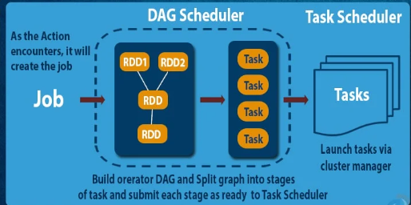
DAG:-Directed Acyclic Graph
It is a fundamental concept used to represent the logical execution plan of a spark application.
The DAG captures the sequence of transformations and actions applied to RDDs and represents the data flow and dependencies between the operations.
DAGs are useful for representing many different types of flows, including data processing flows.

Slide 10
THANKYOU ALL

